Slide 1
Machine Learning and Power BI

Slide 2

Machine Learning is the process of using data to make a determination or prediction about something

Slide 3
Some ML terms
Input variables
Output variable
Model parameters
Hyper parameters

Slide 4
Identify the ML problem
Collect and prepare your training data
Take action and save $$$ ☺
Feature Engineering (missing values, feature selection, feature transformation)
Train the model (select algorithm and tune hyper parameters)
Validation (select metric, Training test split, cross validation)
Collect new data and retrain
Tune and optimize for deployment
Make predictions
Steps in Machine Learning

Slide 5
Identify ML problem

Slide 6
Use Cases
Which applicants should you target for conversion? Which customers might purchase a product? Which customers would default on their payment?

Slide 7
Feature engineering

Slide 8


Slide 9
Types of models

Slide 10
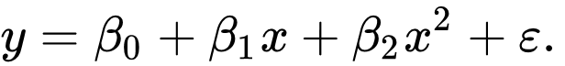
Regression
Predict numerical fields
Examples:
Revenue from a sales deal
Predict house prices

Slide 11
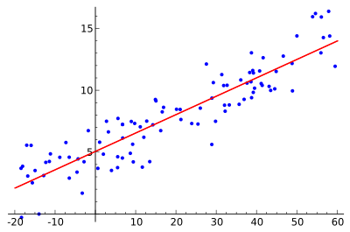
Linear regression
Example of simple linear regression, which has one independent variable
https://en.wikipedia.org/wiki/Linear_regression

Slide 12
Binary prediction
Classify a dataset into two groups
Predict events that have binary outcome
Examples:
Sales opportunity that will convert or not
Account will churn or not
Transaction is fraudulent or not

Slide 13
Classification
Classifying data into multiple groups/classes
To predict events that have multiple possible
outcomes
Example:
Risk for default is high, moderate, low and so on

Slide 14
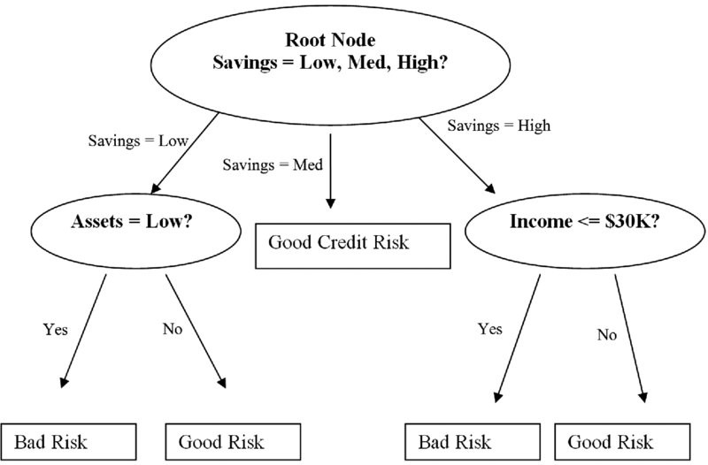
Decision Tree
Source: medium.com/greyatom

Slide 15
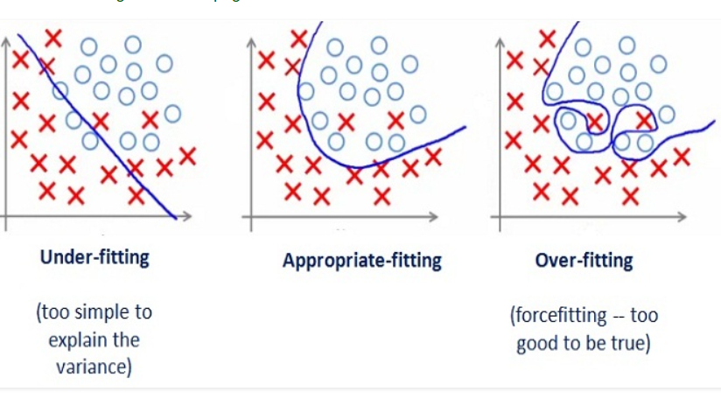
Model fitting
Source: medium.com/greyatom

Slide 16
Training set, Validation set, Holdout set

Slide 17
Cross validation
Data
Training Data |  |  |  |  | Testing Data
Fold 1 | Fold 2 | Fold 3 | Fold 4 | Fold 5
Fold 1 | Fold 2 | Fold 3 | Fold 4 | Fold 5
Fold 1 | Fold 2 | Fold 3 | Fold 4 | Fold 5
Fold 1 | Fold 2 | Fold 3 | Fold 4 | Fold 5
Fold 1 | Fold 2 | Fold 3 | Fold 4 | Fold 5
 |  |  |  |  | Testing Data
Finding parameters
Final evaluation

Slide 18
Performance metric

Slide 19
Why Automated Machine Learning

Slide 20
AutoML in PowerBI
Uses AzureML behind the scenes Zero code - Most of data science is automated Explanations for predictions – global and local
Power BI premium, embedded

Slide 21
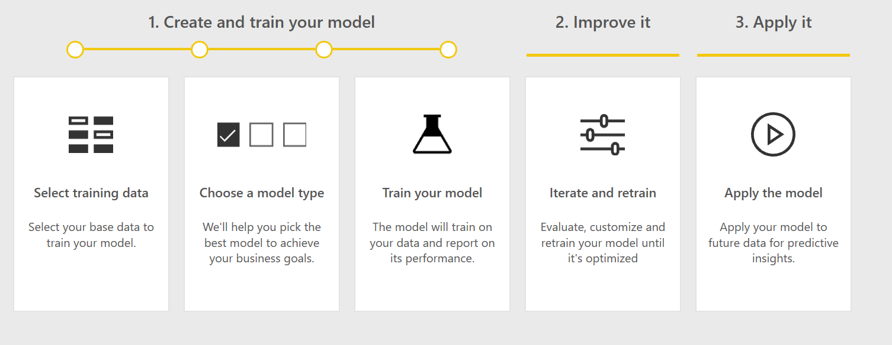
AutoML process

Slide 22
Dataflows
Prepare and cleanse your data
Unify data from disparate sources
Transform data
Set refresh schedules

Slide 23

Data collection
Labelled data
Good data distribution
Real world representation to capture all predictive signals
Recent data
Add more fields to make training data richer
Model is only as good as the data you bring in
Overfitting, underfitting
Don’t bring in data that is not there at time of prediction.

Slide 24
Amount of data
Type of Model | Data limits
Binary prediction | At least 20 rows per class
Classification | At least 20 rows per class, Max 500 classes
Regression | 100 rows
This doesn't mean 20 data points will train a highly predictive model. Try to provide 1000 or more.

Slide 25
Data preparation
Change types
Impute missing values
Correct improperly formatted data

Slide 26
Auto recommendation of model
Model | Type of output
Binary prediction | Text and numeric
Classification | Text and whole numbers
Regression | Numeric
Based on sample of your data – first 1000 rows

Slide 27
Leaky features
Data that is directly dependent on the outcome field
Label leakage could be a possible concern in AutoML models, when:
Model performance is too good to be true.

Slide 28
Feature recommendation
Feature | Recommendation
Only 1 value for categorical features | ☒ Only 1 value found
> 10% distinct values for categorical features | ☒ Too many distinct values
Single feature predicts outcome | ☒ Suspiciously high correlation with outcome – Leaky features
Run key influencers – Not key drivers | ☒ Low correlation
Rest of the features | Recommended
Based on sample of your data – first 1000 rows
What to do when sampling fails

Slide 29
Sampling
Type of model | Sampling
Prediction, Classification | Stratified Sampling followed by class balancing
Regression | Random Sampling
Bring equally balanced data to maximize data use

Slide 30
Pre-processing and Auto Featurization currently done in AutoML
Drop high cardinality features
Impute missing values
Generate additional features
Scaling and normalization
Transform and encode
When using the model for predictions, the same pre-processing steps applied during training are applied to your input data automatically.

Slide 31
Feature transformations
Feature Type | Transformation
Numeric | Numeric features with few unique values are transformed into categorical features
Categorical | One-hot encoding is performed for low cardinality categorical
Categorical Hash | For high cardinality data, one-hot-hash encoding

Slide 32
Missing values
Feature Type | Value used to fill in missing values
Numeric | Mean
Categorical | Mode
Data is missing due to data collection issue vs there is no data in reality
Categorical – use a default value
Numeric – use business insights
Drop if Too many missing values in one field

Slide 33
Generate additional features
DateTime features: Year, Month, Day, Day of week, Day of year, Quarter, Week of the year, Hour, Minute, Second.
Text features: Term frequency based on unigrams, bi-grams, and tri-character-grams.

Slide 34
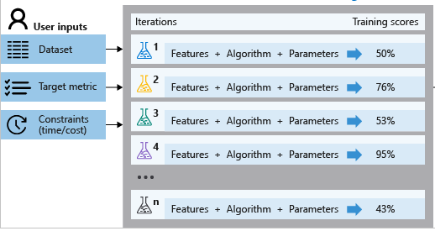
Training
AzureML creates a number of parallel pipelines that try different algorithms and parameters.
Source: docs.microsoft.com/en-us/azure/machine-learning/service/concept-automated-ml
Exit score, time out

Slide 35
Metrics
Model type | Metric
Binary prediction | AUC
Classification | AUC
Regression | R2

Slide 36
Explainable AI
How do you know whether the model is doing the right thing?
Provide interpretability & explainability for models
Not a black box
Convince key stakeholders and customers

Slide 37
Global explanations
This helps show whether your model is trained as you expect.
Validate that top predictors align with business insights about outcome.

Slide 38
Local explanations

Slide 39
Retrain model
Updating the configuration
Adding more training data
Updating the training data in response to changing conditions

Slide 40
What next
Scheduled refresh for automatic predictions on new data and up to date predictions
Incremental refresh to predict only on new data

Slide 41
Precision and Recall
Source: wikipedia.org/wiki/Precision_and_recall

Slide 42
Choice | Why? | Example
High Recall | You want the model to be liberal when labelling outcomes as [targets], to ensure that you don’t miss any. This means some [non-targets] will slip through the cracks into this category. | False negatives is not acceptable/ has a high cost - Predicting cancer patients
High Precision | You only want the model to label outcomes as [targets] when confidence is high, to minimize mislabeling. This means some [targets] will be missed. | For video recommendations, false-negatives is less of a concern. Precision is better here.
Balanced recall and precision | You want the predictions to be as correct as much as possible. You know you’ll miss some [targets] and mislabel some [non-targets].

Slide 43
Troubleshooting
How to check for errors
Out of memory errors
Training errors and issues

Slide 44
AzureML to PowerBI

Slide 45
Automated ML in Power BI | Automated ML in Azure
Designed for the business analyst/BI professional | Designed for the data scientist/data engineer
Skillset required is Power Query and Power BI dataflows (OOB point and click functions, M code) | Skillset required is Azure, Python and Jupyter notebooks
ML model lives completely inside Power BI and can only be used by Power BI | ML model lives in Azure and can be consumed as a webservice by lots of different applications (including Power BI)
Requires Power BI Premium and utilizes capacity | Requires an Azure subscription and utilizes Azure consumption

Slide 46
Takeaways
Auto ML in Power BI enables:
Analysts to build their own machine learning model without writing any code
Extension points for data scientists to bring in machine learning models they created elsewhere
Exporting models they create in Power BI to Jupyter/Azure notebooks (planned capability)

Slide 47
Algos and significance tests
Type of analysis | Visual component | Algorithm | Significance Test
Categorical | Key influencers | LbfgsLogisticRegressionBinaryTrainer | Chi square
Categorical | Segments | FastTreeBinaryTrainer | Chi square
Numeric | Key influencers | SdcaRegressionTrainer | t-test
Numeric | Segments | FastTreeRegressionTrainer | t-test
Notes:
The visual uses a p-value of 0.05 to determine the threshold.

Slide 48
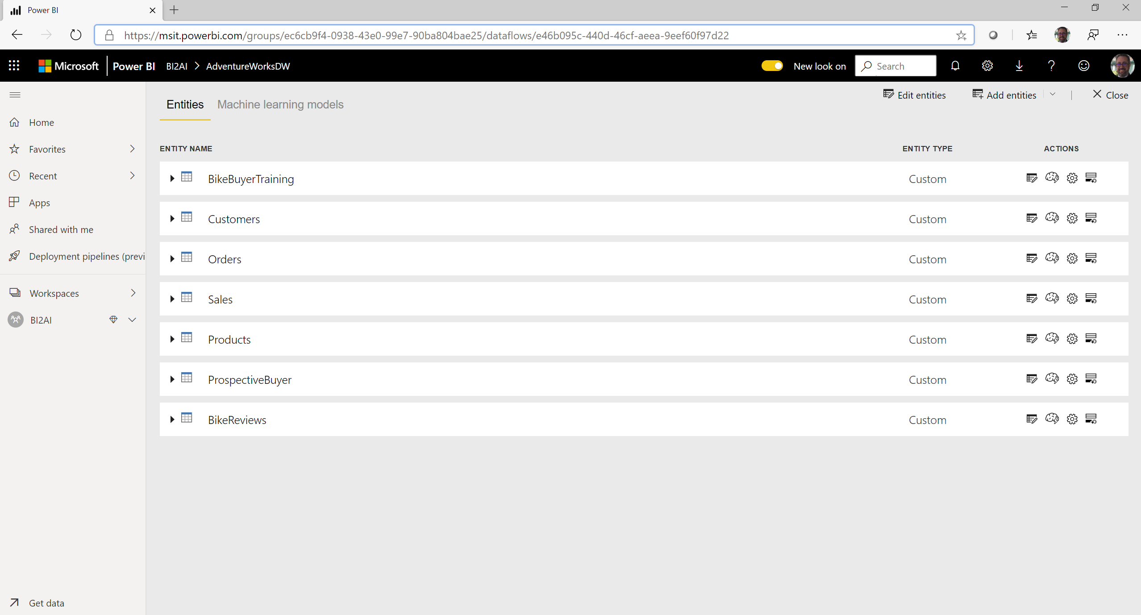

Slide 49
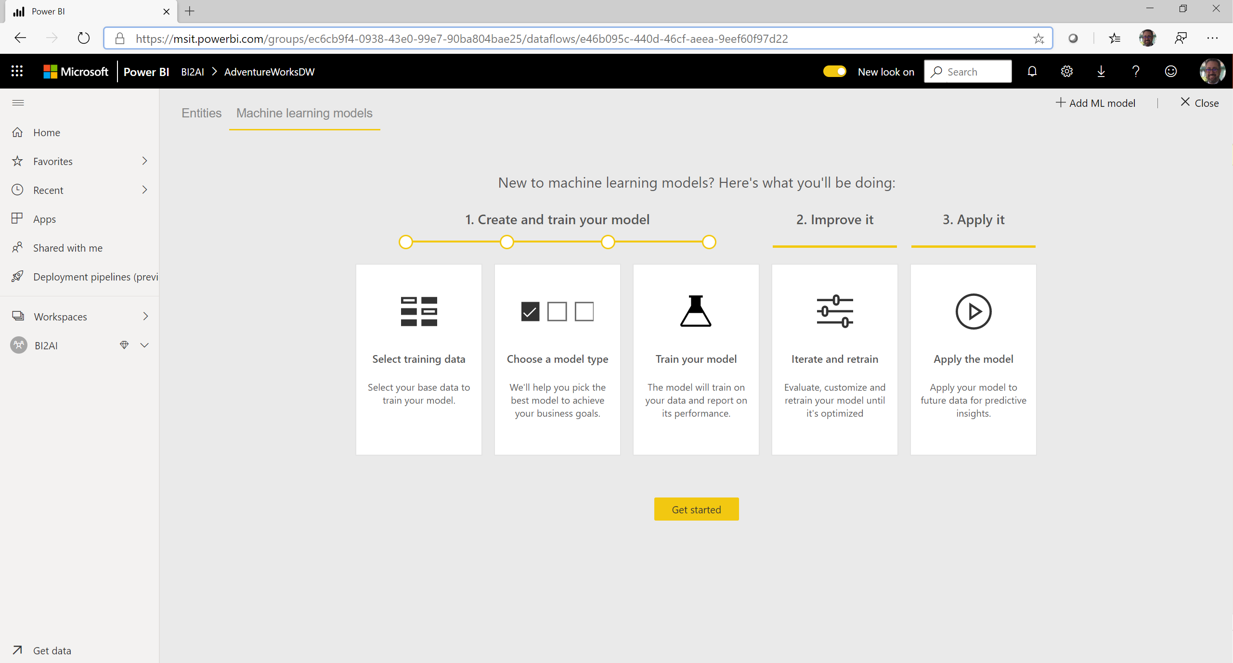

Slide 50
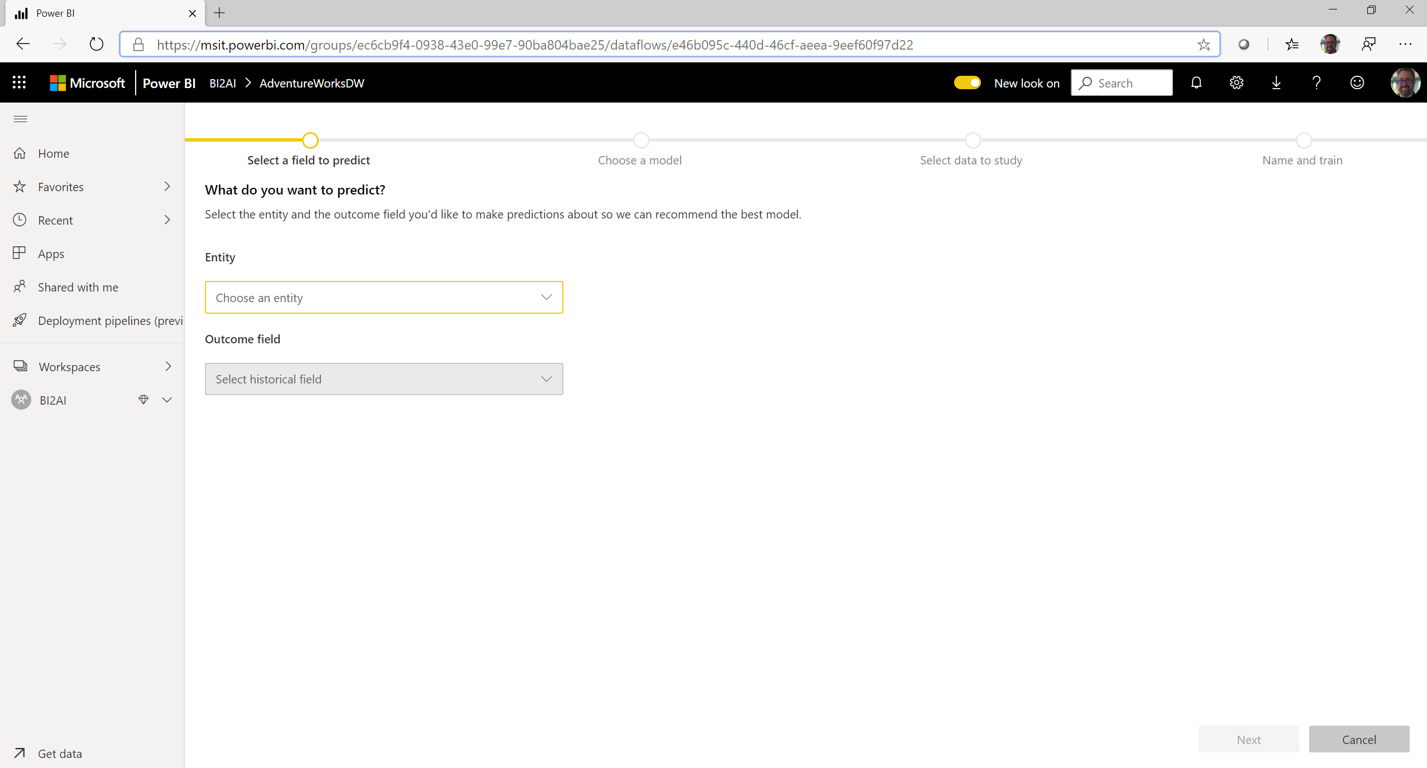

Slide 51
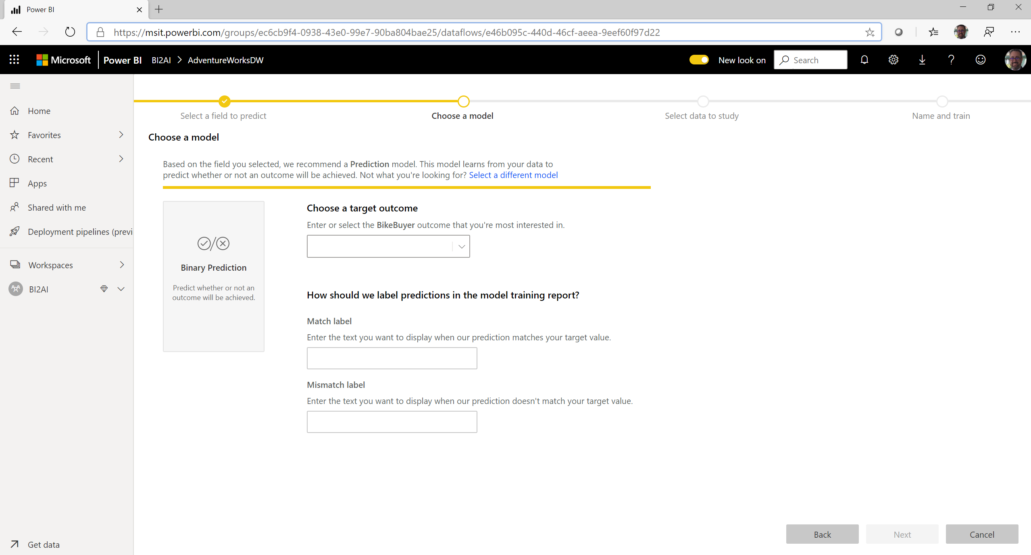

Slide 52
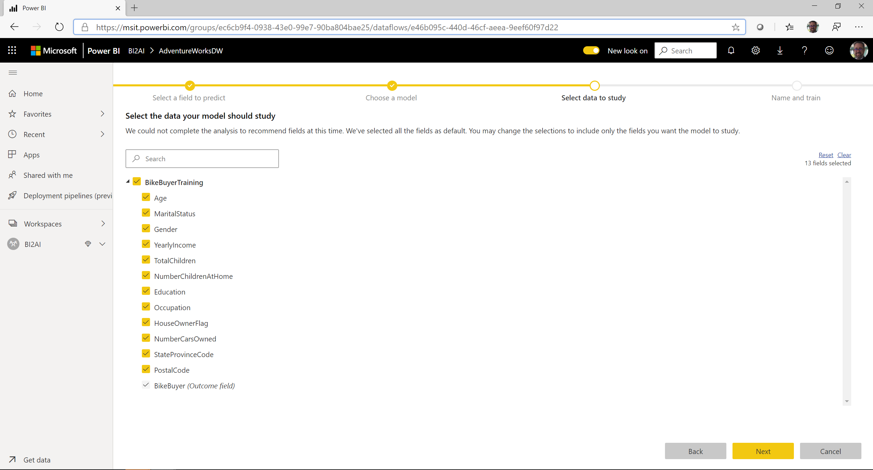

Slide 53
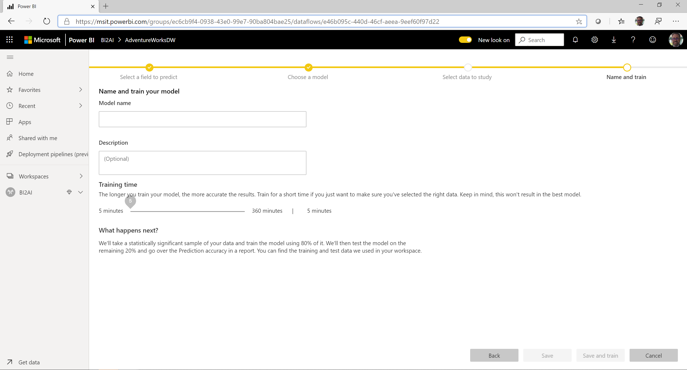

Slide 54
Call to action
Try some of our guides:
https://docs.microsoft.com/en-us/power-bi/service-machine-learning-automated
https://docs.microsoft.com/en-us/power-bi/service-tutorial-build-machine-learning-model
https://docs.microsoft.com/en-us/power-bi/natural-language/q-and-a-intro
https://docs.microsoft.com/en-us/power-bi/visuals/power-bi-visualization-influencers
https://docs.microsoft.com/en-us/power-bi/service-cognitive-services
https://docs.microsoft.com/en-us/power-bi/visuals/power-bi-visualization-decomposition-tree

